Slide 1
Survival Prediction using R
Rajashri.N
DBA17013

Slide 2
Business Case
Using R to predict the survival of patients having given dependent variables like age, sex, weight loss, meal and other medical parameters using R.

Slide 3
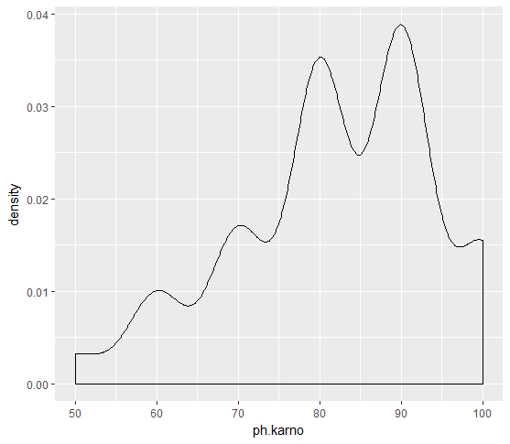
Exploratory Data Analysis
ggplot(new,aes(ph.karno))+geom_density(kernel = "gaussian")
##density plot shows that the data having ph.karno is high for value 90

Slide 4
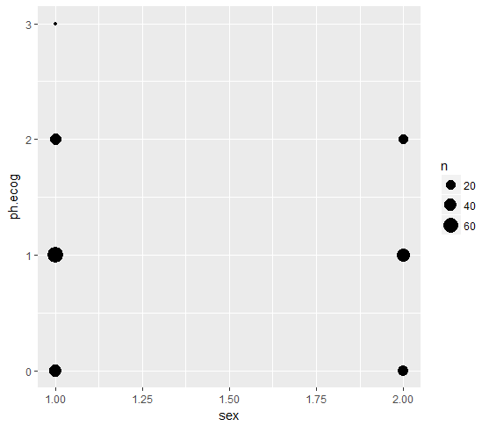
ggplot(new,aes(sex,ph.ecog))+geom_count()
##ph.ecog has 0-3 levels ,sex has 2 levels 1 & 2 ,plot shows more counts for ph.ecog level 1 for both 1&2 levels ## for sex - 1 level 3 is lower & sex -2 no count under level 3

Slide 5
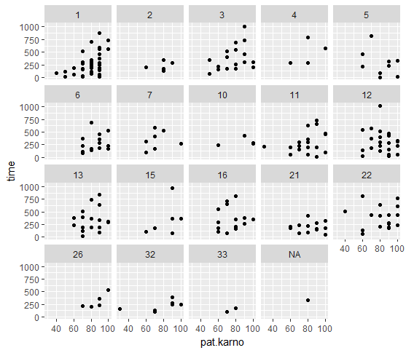
ggplot(new) + geom_point(aes(x = pat.karno, y = time)) + facet_wrap(~inst)
##visuals show inst 1 has more data points with pat.karno 100 and inst 33 has fewer data points

Slide 6
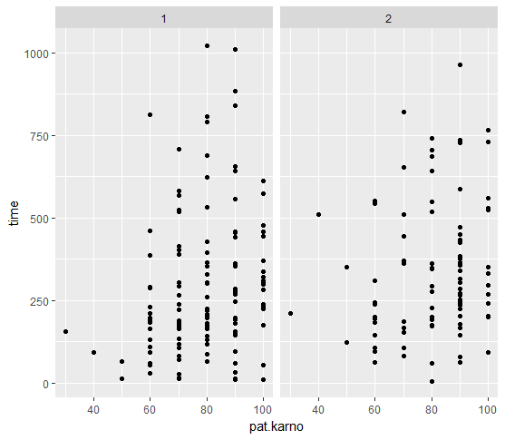
ggplot(new) + geom_point(aes(x = pat.karno, y = time)) + facet_wrap(~sex)
##Higher pat.karno higher time suvived

Slide 7
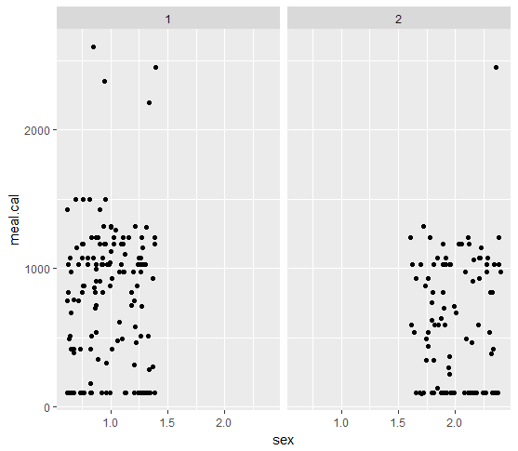
ggplot(classif)+geom_jitter(aes(x = sex , y = meal.cal))+facet_grid(~sex)
##gender 1 shows few data points having high calorie meal, gender 2 has inly 1 point having high calorific meal

Slide 8
Data Pre Processing
Summary statistics showed that there are missing values in the data set for the following columns
inst ,ph.ecog,ph.karno,pat.karno,meal.cal,wt.loss
Using Hmisc package imputation is done to replace missing.
Dummy Coding :
Since our status colum has levels other than 0 & 1 dummy coding is done to replace level 1 to 1and level 2 to 0.

Slide 9
Model Building
Using stepwise selection for picking best parameters,
Forward selection - 118.6
Backward selection - 119.3
This method seems give minimal AIC having all factors in,seems less reliable. Using other methods for predcition.

Slide 10
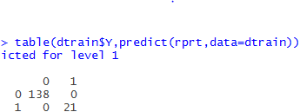
Using ‘rpart’ & ‘glm’ to predict the status.
Confusion matrix shows predicted values for test set,
100% accuracy is achieved for test set.
Precision is 100% for both the models,as we are predicting survival of patients having high precision is desirable.

Slide 11
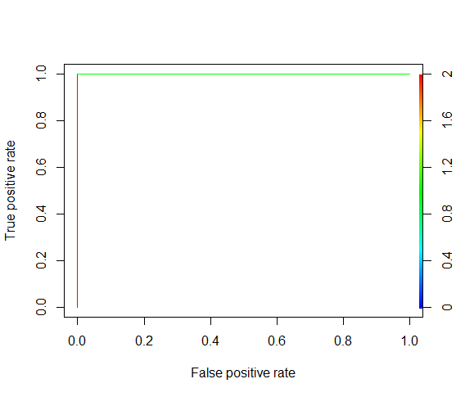
Roc Curve
Using ROC Curve for validation, graph shows exact fit.

Slide 12
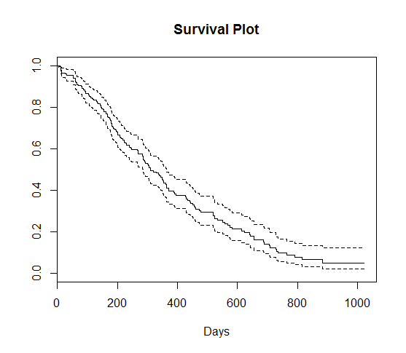
Using Surv() function in R
Using Surv() – to validate the fact that time & status are correlated.
km_fit <- survfit(Surv(time, status) ~ 1, data=classif)
plot(km_fit, xlab="Days", main = 'Survival Plot')

Slide 13
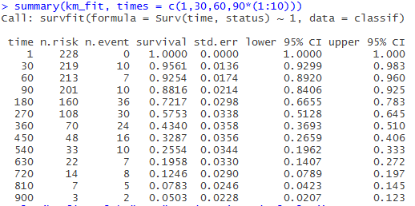
Using Surv() function in R
summary(km_fit, times = c(1,30,60,90*(1:10)))
##Summary shows that as time increases the survival rate decreases

Slide 14
Thank you!!

